Slide 1






GROUP 2
Rostering problem
Fundamentals of optimization

Slide 2



Problem description
ROSTERING PROBLEM
There are N employees 1,2,..,n works in day 1,2,...,N. A day is split into four shifts: morning,noon,afternoon,night
Each day, a employee only works in 1 shift
Who worked at the night in the previous day will have a day off
Each shift has at least a employees and max of b emplyees
F(i) is a list of days off of employee i
The maximal number of night shifts of any employee is minimized

Slide 3


Our approach
WHAT WE WANT TO PRESENT IN THIS SLIDE
Data generator
Linear Programming
Constraint Programming
Heuristics
Data analysis

Slide 4

1.Data generator

Slide 5
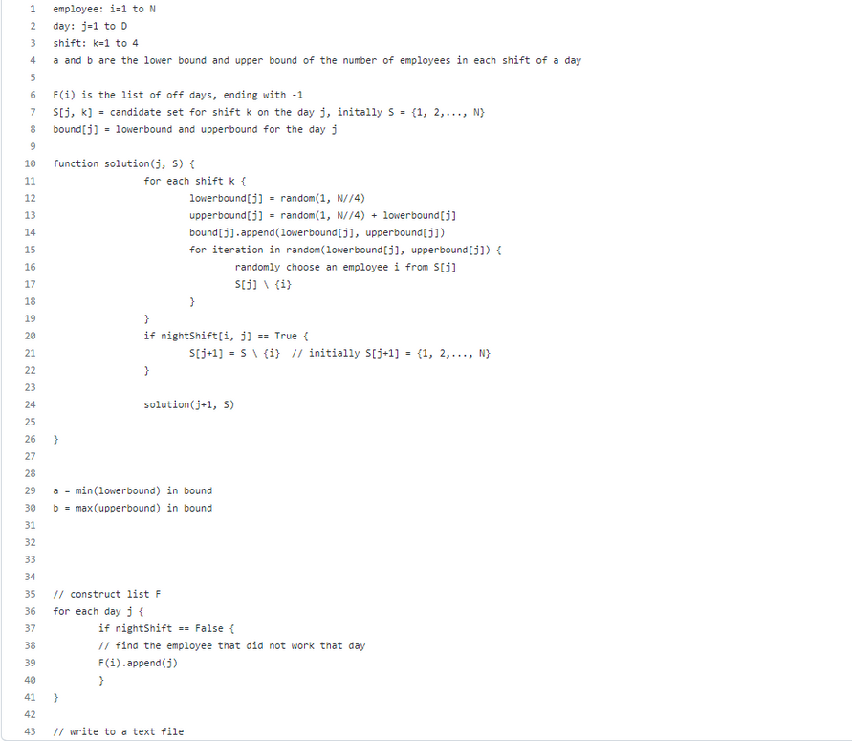
Data generator
-Step 1: Use the recursion function
-Step 2: Save the night shift random result into a matrix
-Step 3 : Construct the list F(i)
-Step 4 : Write the input into a text file

Slide 6

2.Linear progamming

Slide 7

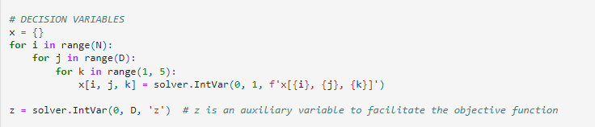

LP solution
1. Decision Variables
+) X[i,j,k] = 1 if staff i work on phase k of day j , 0 otherwise Such that: 1≤i≤ N, 1 ≤ j ≤ D, 1 ≤ k ≤ 4

Slide 8
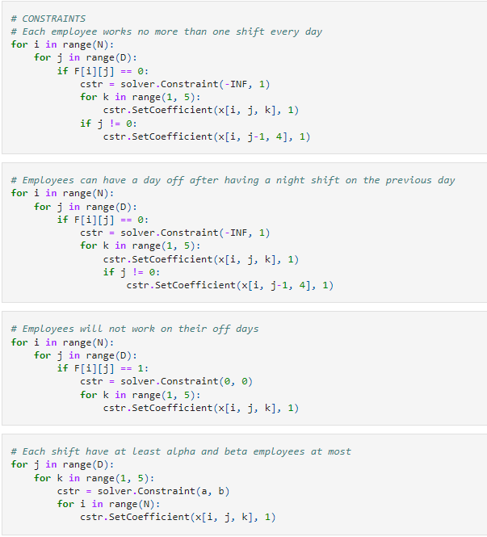
LP solution
2.Constraints
+)Each employee works no more than one shift every day:∑1≤k ≤ 4X[i,j,k] ≤ 1,for1 ≤i≤ N,1 ≤ j ≤ D
+)Employees can have a day off after having a night shift on the previous day:
X[i,j-1,4] + ∑1 ≤ k ≤ 4X[i,j,k] =1 ,for 1 ≤i≤ N,1 ≤ j ≤ D
+)Employees will not work on their off days:
∑1≤k≤ 4X[i,j,k]= 0,for1 ≤i≤ N,j∈F[i]
+)Each shift will have at least α employees and β at most:
α≤ ∑1≤i≤NX[i,j,k] ≤β ,for1 ≤ j ≤ D, 1 ≤ k ≤ 4

Slide 9
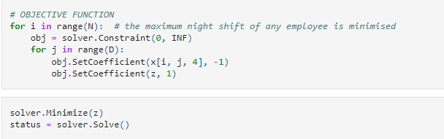
LP solution
3. Objective function
Z = max Σ 1≤j≤D x[i, j, 4], for 1 ≤ i ≤ N
-> Minimise Z

Slide 10
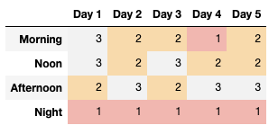
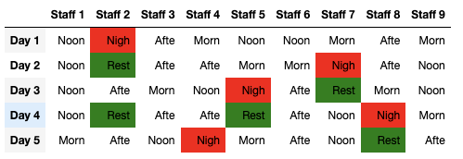
LP solution
4.Output
Number of employee in a shift
Schedule of each employee

Slide 11
3.Constraint progamming

Slide 12

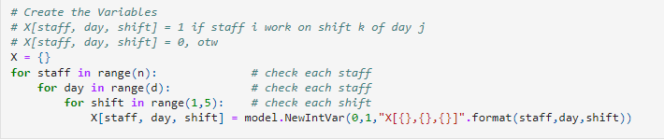
CSP solution
1. Decision Variables
+) X[i,j,k] = 1 if staff i work on phase k of day j , 0 otherwise Such that: 1≤i≤ N, 1 ≤ j ≤ D, 1 ≤ k ≤ 4
+) Y[i,j] = 1 if staff i have a day off on day j, 0 otherwise

Slide 13
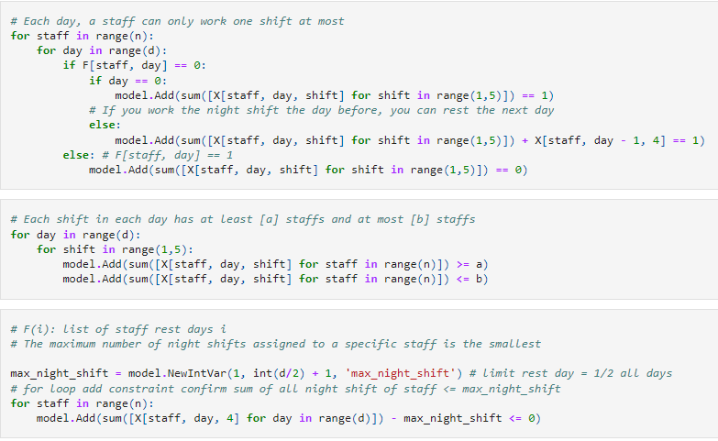
CSP solution
2.Constraints
Each employee works no more than one shift every day:
∑1≤k ≤ 4X[i,j,k] ≤ 1,for1 ≤i≤ N,1 ≤ j ≤ D s.t Y[j] = 0
Employees can have a day off after having a night shift on the previous day:
X[i,j-1,4] + ∑1 ≤ k ≤ 4X[i,j,k] =1 ,for 1 ≤i≤ N,1 ≤ j ≤ D,
Y[j] = 0
Employees will not work on their off days:
m[i]= ∑1 ≤ j ≤ DX[i,j,4], for 1 ≤i≤ N
Each shift will have at least α employees and β at most:
α≤ ∑1≤i≤NX[i,j,k] ≤β ,for1 ≤ j ≤ D, 1 ≤ k ≤ 4

Slide 14
CSP solution
3. Objective function:
m[i] ≤ N => N min

Slide 15
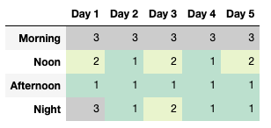
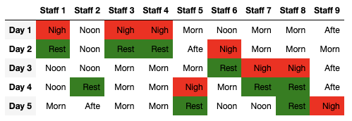
CSP solution
4.Output
Number of employee in a shift
Schedule of each employee

Slide 16

4.Heuristics

Slide 17
Heuristics
1. Our idea
For each day, we will assign employees to the night shift such that all the conditions are satisfied, and also incurs the smallest number of night shifts of employees (thus still optimising the total number of night shifts).
=> prioritise employees with minimal number of current night shifts and employees that have off days on the next day.

Slide 18
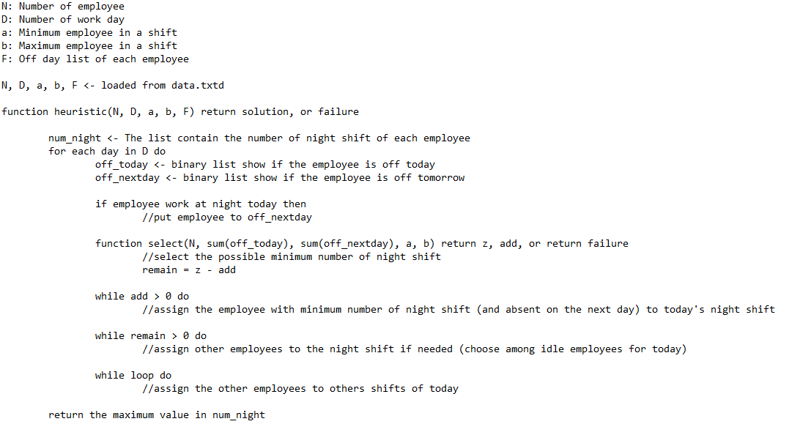
Heuristics
Heuristics function

Slide 19
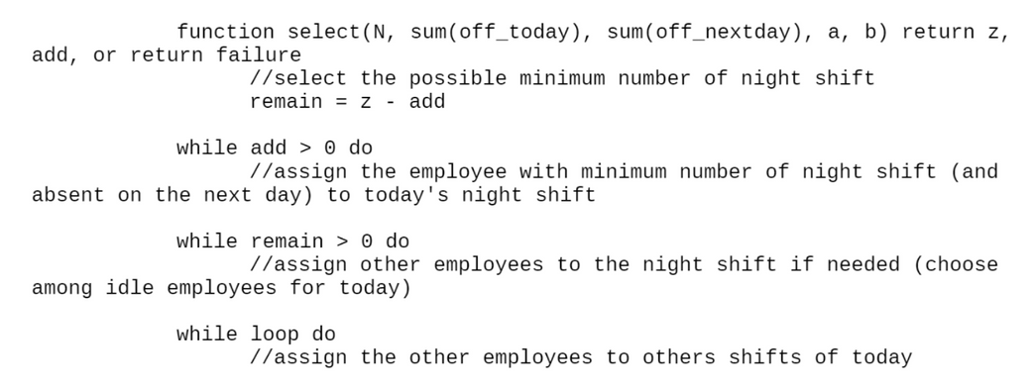
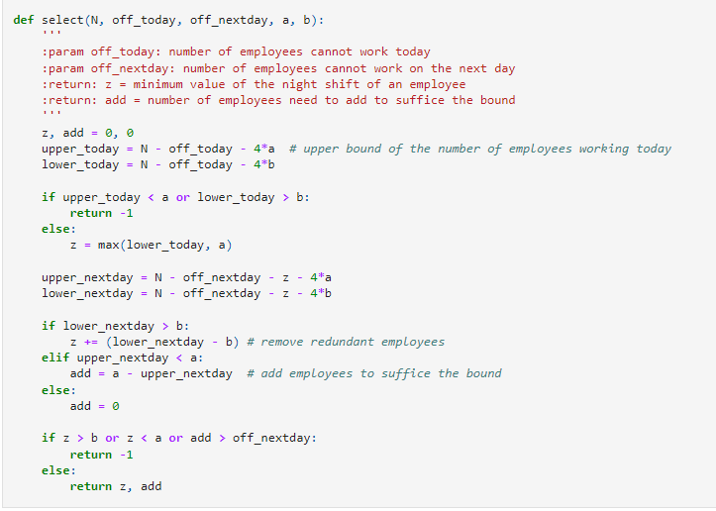
Heuristics
2.select function
Pseudo code
Python code

Slide 20
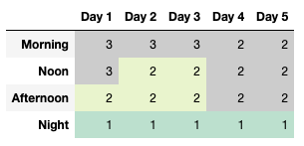
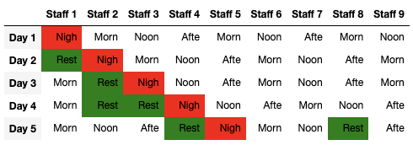
4.Output
Heuristics
Number of employee in a shift
Schedule of each employee

Slide 21
5.Data analysis

Slide 22
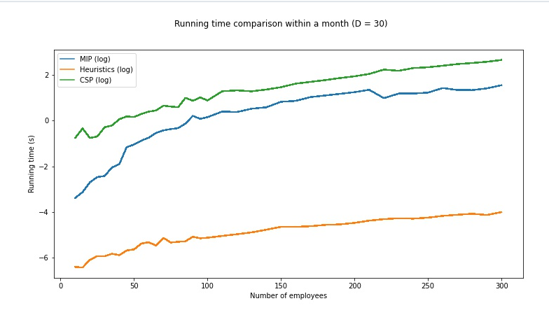
Data analysis

Slide 23
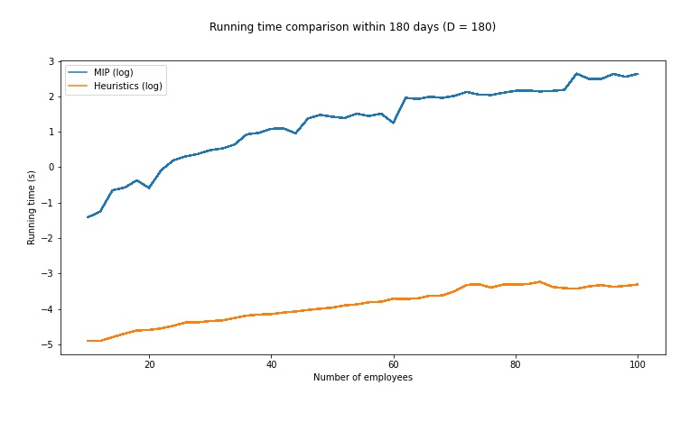
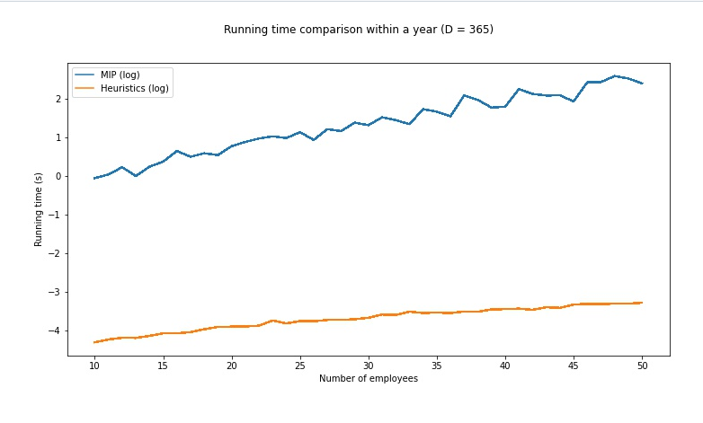
Data analysis

Slide 24
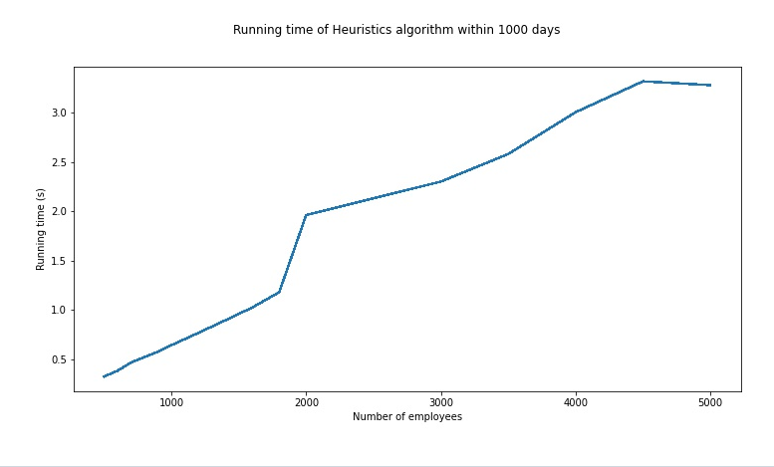
Data analysis

Slide 25
Member
Task
60% heuristics
modeling CP
50% slides
Nguyen Huu Tuan Duy
data generation
50% slides
modeling ILP
Hoang Gia Nguyen
Le Duc Anh Tuan
Code CP
Visualization
Code ILP
40% Heuristics
Analysis
Hoang Long Vu

Slide 26


